Slide 1
Vince’s Vinyl Principles of Database Design Presented by Beverly Gagnon March 25, 2020
Notes:
This is the second part of my final for Principles of Database Design. It is based of the scenario of Vince’s Vinyl. The first part was a business report, submitted for Module 9.

Slide 2

HELLO!
I am Beverly Gagnon
Third-year graduate student at Southern New Hampshire University
You can find me at beverly.gagnon@snhu.edu
Notes:
Hello, my name is Beverly Gagnon. I am a student at Southern New Hampshire University, studying for my Masters in Data Analytics. I am in my third year (so you do not forget who you are).

Slide 3
Overview
1. Summary of Problem
2. Database Design
3. Recommendations & Defense of DBMS Products
4. Enterprise Data Model for Inventory
5. Security Management Plan
Notes:
This presentation will cover the 5 main elements of database design.
Summary of the problem with Vince’s Vinyl has
The steps needs to create a database design
DBMS Product to be used and comparison
We’ll go over an enterprise data model for the element of INVENTORY for Vince’s Vinyl
Suggest a security management plan to be implement for this database

Slide 4
1.
Summary of the Problem
Current state of Vince’s Vinyl….
Notes:
Vince’s Vinyl is a record store in the University District. The store sell new and used records. Vince buys is inventory from yard sales, dealers, discount stores and customers. For the last few years, Vince has kept most of his inventory notes either in his head or in a spiral notebook he keeps behind the sale counter. His business has grown along with his inventory.

Slide 5
Problem/Challenge
Inventory What do you have? What is it worth? What did it cost to obtain? What condition is it? Where did this album come from?
Sales
What has been sold?
Requests Who wants what?
Online in the Future
Notes:
Vince’s Vinyl has issues that can be solved by a database.
Vince has not any idea about the state of his inventory. He doesn’t know what he has, the value, cost to obtain it, what condition the records are or who/where he bought them from.
Vince does not know which albums he still has because he does not keep complete records of his sales.
Vince also wants to keep track of his customer requests so he knows which albums he needs to locate to bring to his customers.
Looking to go online with his store in the future

Slide 6
Problem/Challenge
Current database… Vince’s memory Spinal Notebook
Issue? What if Vince does not remember…
1. The transaction 2. Write it in the spiral notebook or 3. Notebook goes M.I.A.
Notes:
Currently, Vince’s inventory and working database is his memory and his ability to remember to write information down in his infamous spiral notebook.
Issue with the currently system is Vince’s memory, whether or not it was written in the notebook and hoping that the notebook does not go missing or misplaced.

Slide 7

2.
Database Design:
Conceptual Model
Logical Model
Physical Design
(Conger, 2010)
Notes:
To be able to create a database for Vince’s Vinyl: it is best to interview Vince and a couple of his employees to see what they want the database to do. What will is store? What kinds of queries will it be doing.
We work these out with the database design models.

Slide 8
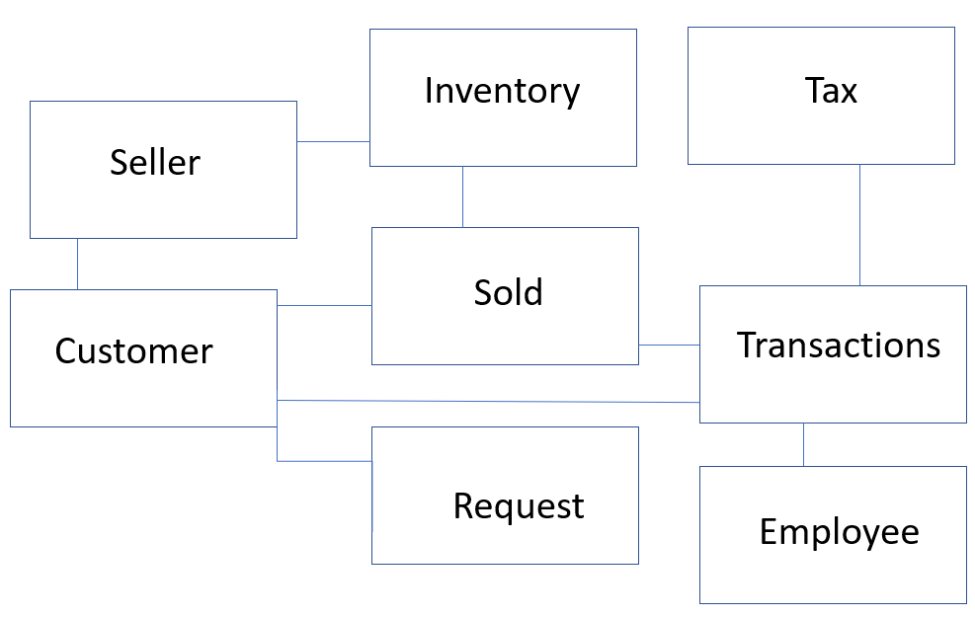
Conceptual Model
Example of a conceptual model for Vince’s Vinyl (Hernandez, 2013)
Notes:
First, we can start with the Conceptual model of the database. It is simple and shows tables the relationships between them.
Vince wanted to know the extend of his inventory, the value of his inventory, where he got it from
Also Vince needs to track his sales, how much is he making and what albums are going out the door?
Vince wants to keep track of the album requests his customer have so he can get to albums the are seeking out.
And lastly, Vince would like to set-up for the future
Talk about: The table connections now:

Slide 9
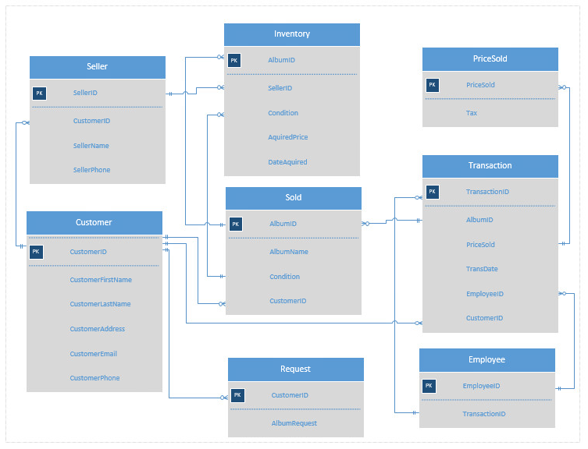
Logical Model
Example of a logical model for Vince’s Vinyl (Hernandez, 2013)
Notes:
The Logical Model show a little more attributes within the table that will be used in the database.
Same tables but with more details on how the tables relate to each other with Primary Keys (shown as PK) and Foreign Keys (shown as FK.).
A primary key is unique to the table it is in and shows up a foreign key in other tables
A foreign key is a primary key in another table in order to create relationships between tables
Same as the conceptual model as the table go but by adding the attributes of table we can see what the tables will include

Slide 10
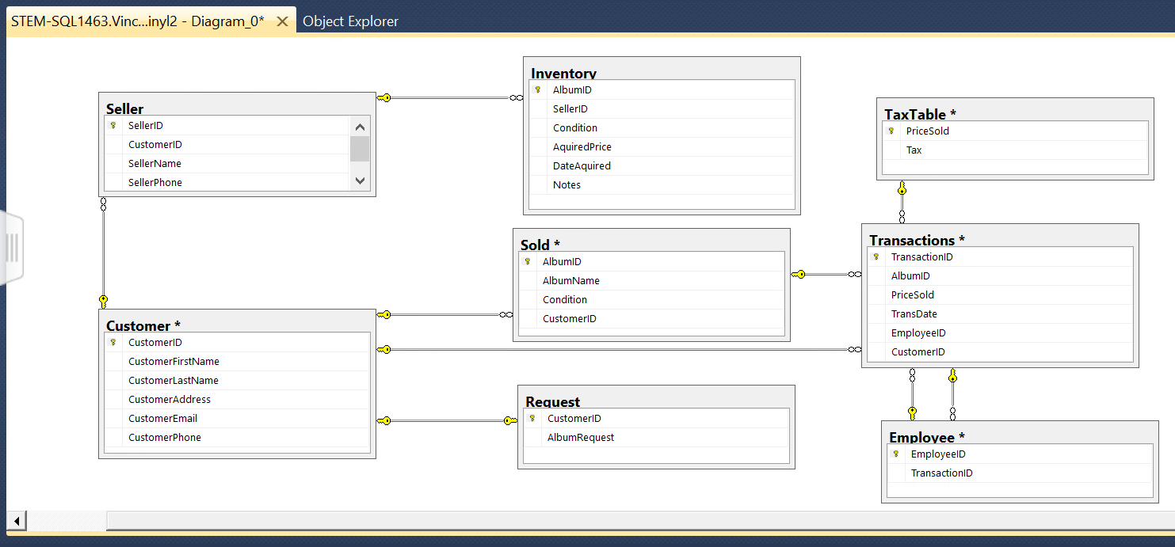
Physical Design
Example of a physical model for Vince’s Vinyl (Soper, 2013)
Notes:
Third is the Physical database, it is a further extension of the first two.
In this step a database designer will add the constraints, data types and null allowances. The attributes are much more defined allowing us to see where this is progressing. The relationship lines show the connections still.
Talk about: table connections now:

Slide 11

3. Recommendation & Defense of DBMS Products
Amazon Aurora
Cloud-Base
Performance and Scalability
Availability and Durability
Highly Secure
Fully Managed by Amazon
Mitigation Support
Mobile Access
(AWS.Amazon.com, n.d.)
Notes:
It was recommended in the report that Vince’s Vinyl use Amazon Aurora for its Database Management System.
Its cloud-base thus no overhead equipment for Vince to buy
Has great performance and is can be expanded as Vince needs more if need be
Being cloud-base makes is always available…no power outage or a flick of the switch will shut down the database
The security it run by Amazon VP and encryption is keyed in by the users
The database will be fully managed by Amazon – Amazon Relational Database Service will babysit the database and be monitored with Amazon CloudWatch
Amazon Aurora supports other platforms so it makes it easy to mitigate information from a various of sources. If Vince’s information is in an EXCEL spreadsheet what he started to try to start a database, that information can be moved over easily.
And – Everyone’s favorite, Vince can access and keep control of his database over his phone with the app.

Slide 12
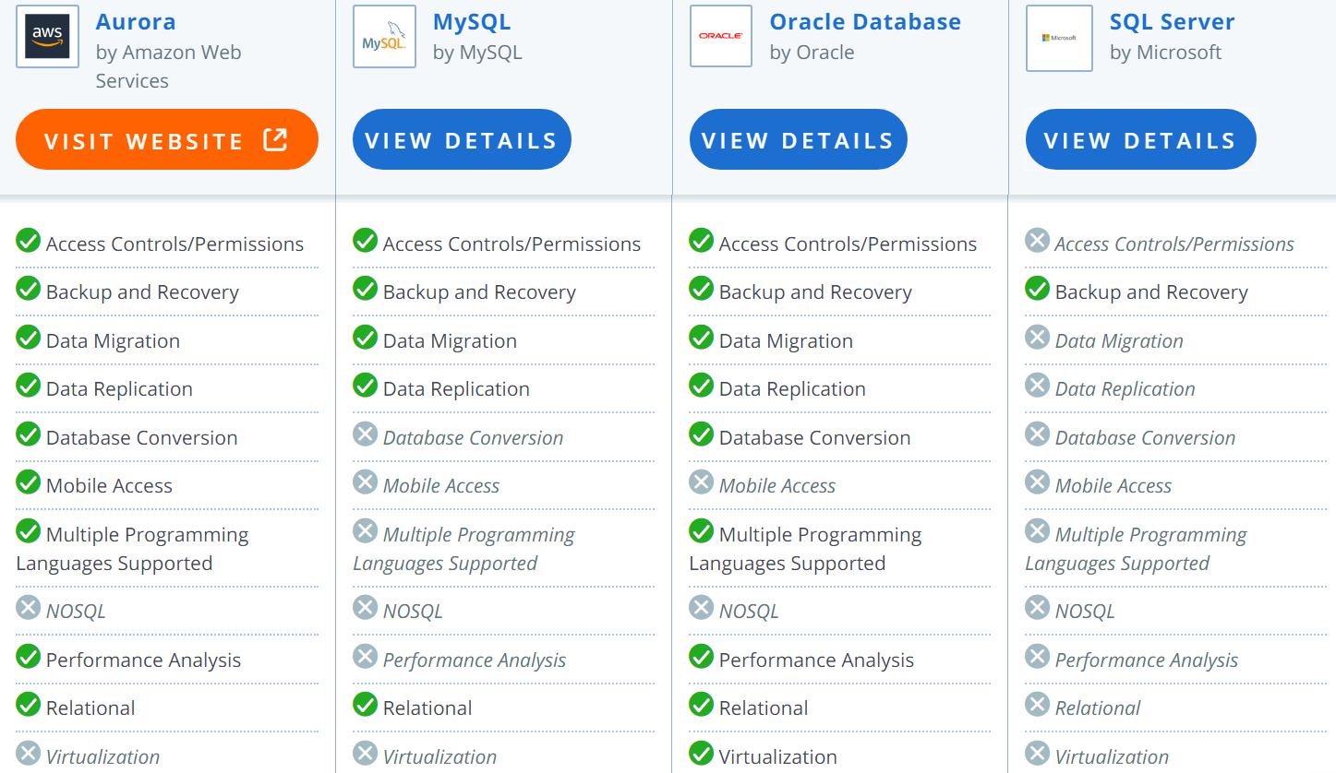
Defense of DBMS Products
👉
(Capterra.com, n.d.)
Notes:
In comparison with other DBMSs Aurora stand up to the others. If Vince can have a creative employee talk control of his visuals (if needed) he can thrive onward with his new database.

Slide 13
Hardware & Software Needed
Hardware
Personal Computer or Laptop
Designated Internet Connection
Hard Drive of at least 6 GB
Memory 512 MB
Software
Cloud-based
Minimum storage of 10 MB
Expanded to 64 TB
In 10 GB increments
Staff training
Online
In-person
Through Documents
Notes:
Amazon Aurora only needs a few hardware and software in order to work.
Read the list….
Not much of investment and he probably already has the computer or get one at a reasonable price.

Slide 14
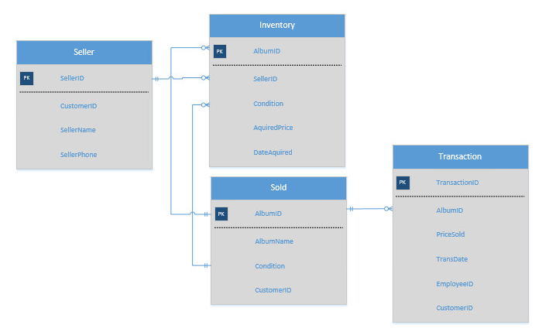
4. Enterprise Data Model
Enterprise Data Model for the Inventory of Vince’s Vinyl
Notes:
Looking an the department of INVENTORY we can look closer on how the database will be working for that particular table/function
The tables needed are the Inventory, Sold, Transaction and Seller tables. As before you can see the relations they have to each other. Each primary key in a table (or parent table) matches up with a foreign key in another (being the child table).

Slide 15
5. Security Management Plan
Standards
Legal Compliance
Ethical Practices
(McAfee, 2012)
🔑
Notes:
Lastly, the security management plan for the database must be established. Remember to include the Standards, Legal Compliance and Ethical Practices of the business before a plan can be created.
Some standard could include: be honest and trustworthy, respect privacy and honor confidentiality.
An example of Legal Compliance is knowing how your company can keep personal data personal.
As for ethical practices, some people could be conflicting…what one person thinks is “doing good” another can think the opposite. It is sometimes a fine line is some cases.

Slide 16
Security Management Plan
- Have a Strong Security Filter
- Use Least Privilege Principle
- Minimize the Attack Surface
- Encrypt
- Develop, Test & Stage
(McAfee, 2012)
🔑
Notes:
Some of the security features that Vince’s Vinyl want to use are:
Having a strong filter to stop hacking from the front line before it reaches the database’s data – Usernames and strong passwords
Having employees see only what they need to see in order to do their job with the privilege principle
Enable to minimize the attack surface the database will be kept as simple as it can be
Remember to encrypt the data but Vince’s Vinyl will only encrypt the private information of it’s customers because encryption can be costly
When you develop a security plan, consistently test it and stage it in the “real-world” to see what happens.

Slide 17
THANK YOU!
Any questions?
You can find me at:
beverly.gagnon@snhu.edu
Notes:
Thank you so much for your attention
If you have any questions you can email me at Beverly.gagnon@snhu.edu and I’ll be happy to answer whatever you have.

Slide 18
References
Aws.amazon.com. (n.d.). Amazon aurora. Retrieved from: https://aws.amazon.com/rds/aurora/?&trk=ps_a131L0000083Z6vQAE&trkCampaign=pc_120_ capterra_Aurora_PDP&sc_channel=ps&sc_campaign=pac_q120_capterra_Aurora_entapps&sc _outcome=PaaS_Digital_Marketing&sc_publisher=Google&sc_medium=Capterra
Capterra.com. (n.d.). Database management software. Retrieved from: https://www.capterra.com/database-management-software/
Conger, S. (2010). Hands-on database Retrieved from https://mbsdirect.vitalsource.com/#/books/9780133927078
Hernandez, M. J. (2013, February 14). Database design for mere mortals, 3rd edition [VitalSource Bookshelf version]. Retrieved from vbk://9780133122275
McAfee. (2012). A practical guide to database compliance. Retrieved from: https://www.ascent.tech/wp- content/uploads/documents/mcafee/practical-guide-to-database-compliance.pdf
Soper, Dr. D. (2013, July 3). Creating primary and foreign keys in sql server 2012. Retrieved from: https://www.youtube.com/watch?v=TpKcAmaaBts

